Slide 1

Is My DSL a Modeling or Programming Language?
Yu Sun¹, Zekai Demirezen¹, Marjan Mernik²,
Jeff Gray¹, Barret Bryant¹
¹ Department of Computer and Information Sciences, University of Alabama at Birmingham
{yusun, zekzek, gray, bryant}@cis.uab.edu
² University of Maribor, Slovenia
marjan.mernik@uni-mb.si
This work funded in part by NSF CAREER award CCF-0643725

Slide 2




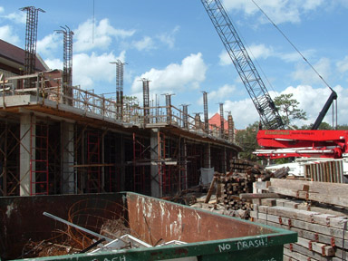

Domain-specific languages
are increasingly POPULAR

Slide 3
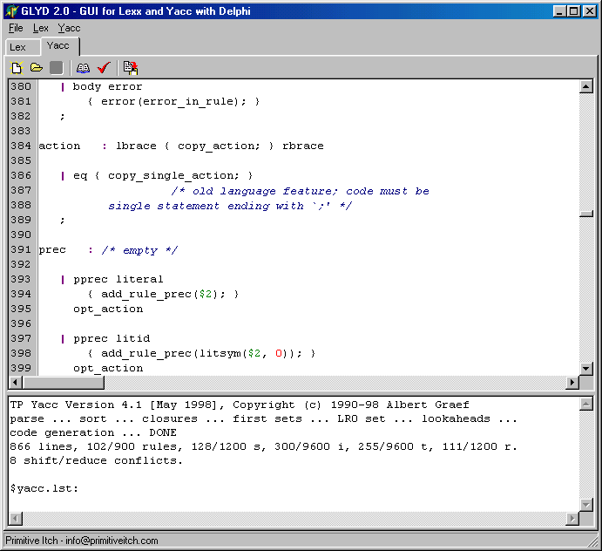
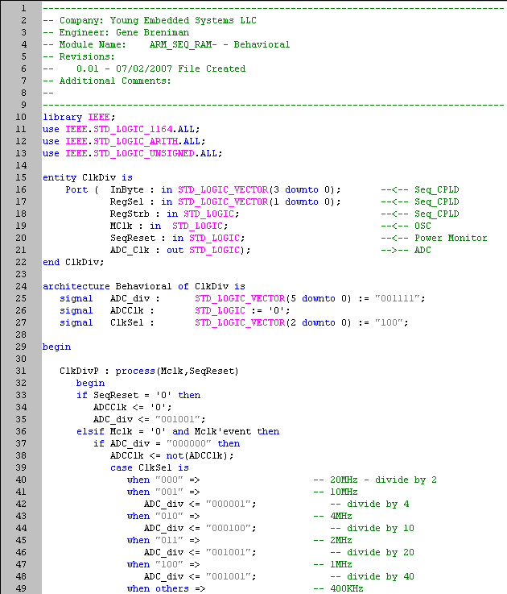
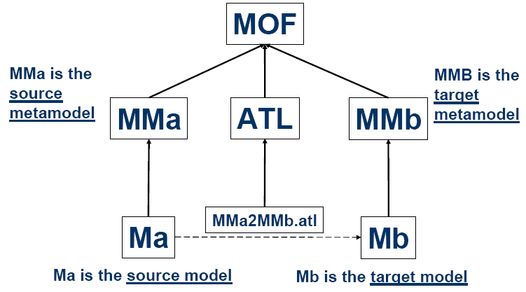
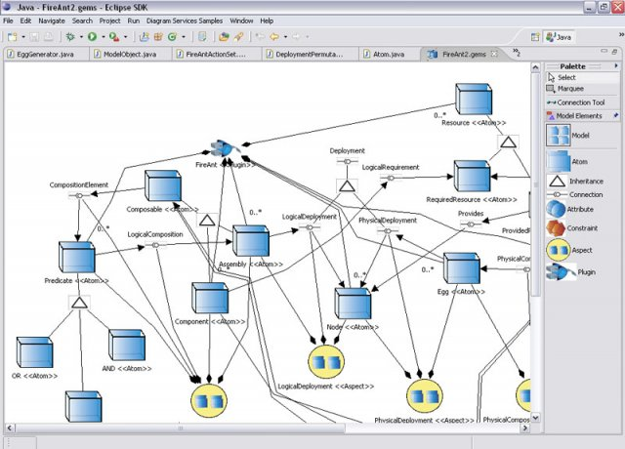
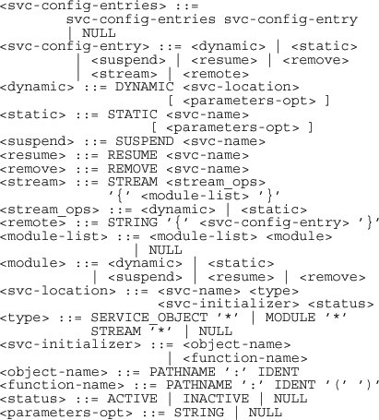


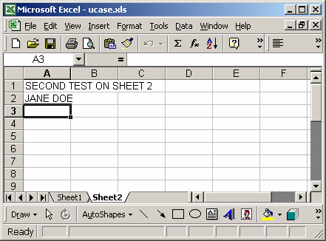
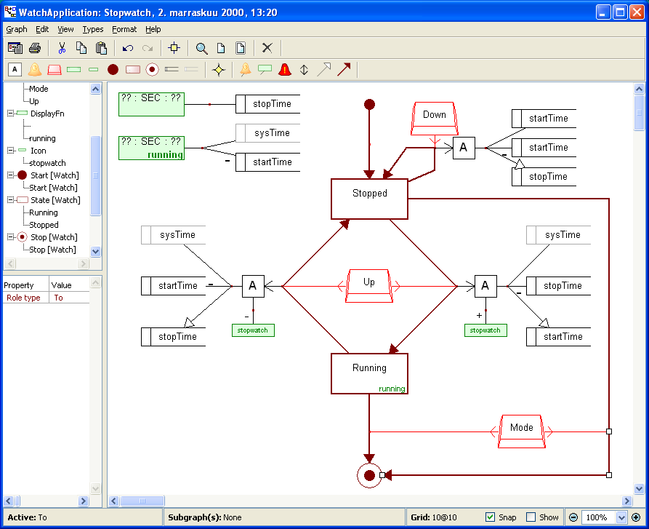
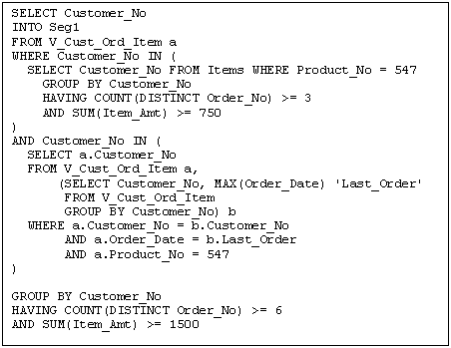
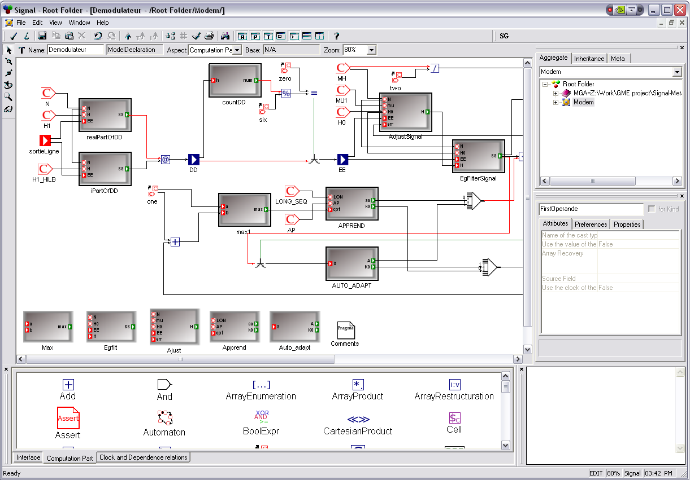
You can make a case for almost anything to be a DSL
ATLAS Transformation Language (ATL)
VHSIC hardware description language (VHDL)
Lex & YACC
EBNF
MetaCase+
Structured Query Language (SQL)

Slide 4
This turned out to be a problem
When we are unable to be specific about what type of domain-specific language we are using, we are forced to eliminate types of DSLs that are not relevant to the current conversation. This elimination process often slows communication with stakeholders.
So, we need to classify DSLs in order to unify our understanding and improve communications.

Slide 5
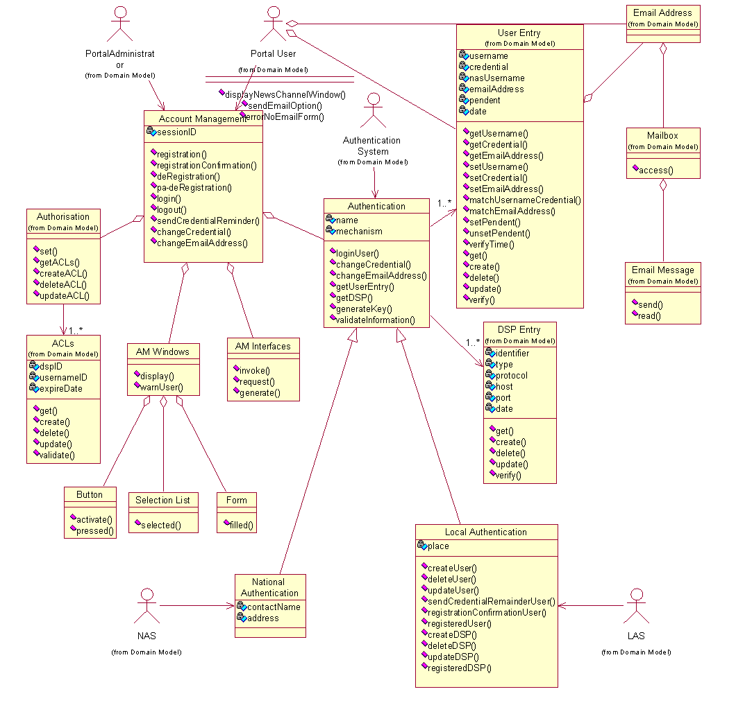
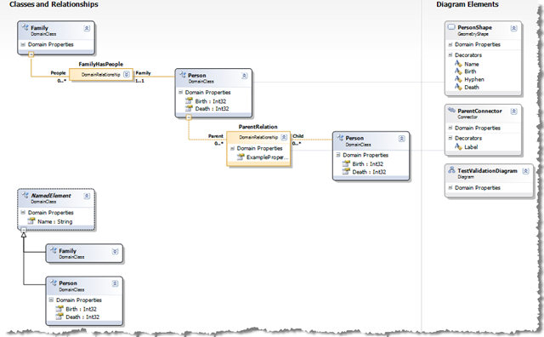
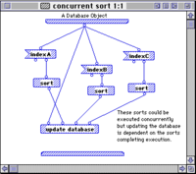
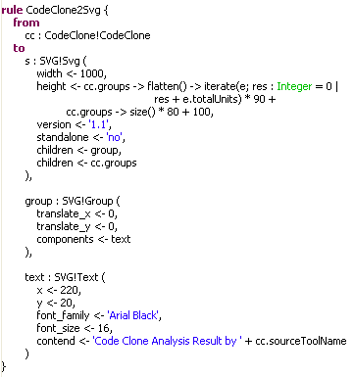
Programming or Modeling?
How to differentiate between a Programming and Modeling Language?

Slide 6

Formal Definitions
“A programming language is a notational system for describing computation in machine-readable and human-readable form.” - Kenneth C. Louden
“A programming language is a notation for writing programs.” - Ravi Sethi
“A modeling language is an organized collection of model unit kinds that focus on a particular modeling perspective.” - Cesar Gonzalez-Perez
“A modeling language is any artificial language that can be used to express information or knowledge or system in a structure that is defined by a consistent set of rules.” - Wikipedia
Too vague to differentiate between PL and ML ☹

Slide 7
Possible Criteria
Concrete Notation
Language Definition
Language Executability
Level of Abstraction
Fundamental Concepts
Development Phase
Multiple Views

Slide 8
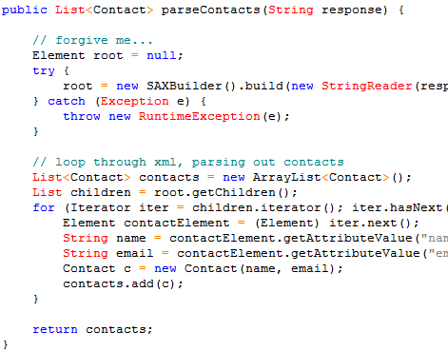
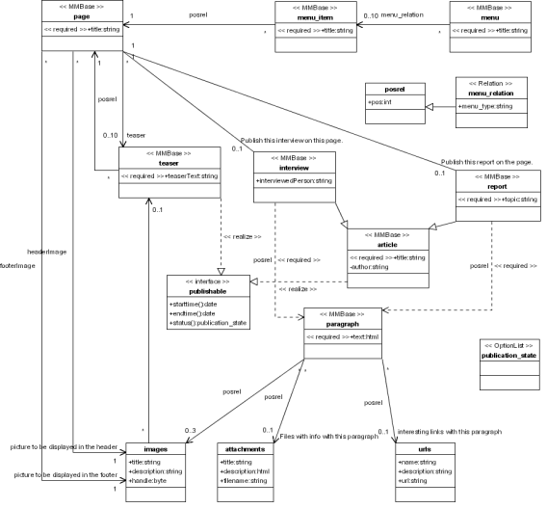
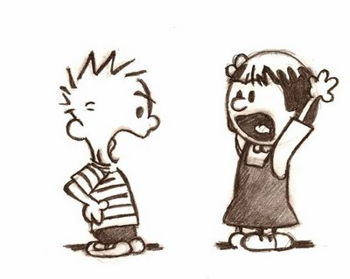
C1. Concrete Notation
Textual
Programming
Language
A lot of visual programming languages exist.
Modeling languages can be textual as well.
Graphical
Modeling
Language

Slide 9
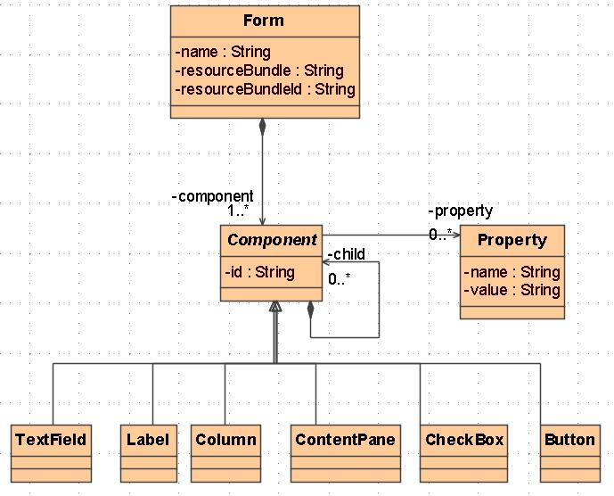
C2. Language Definition
CFG & Formal Semantics
Visual programming languages are not defined by a CFG.
There are modeling languages that are not defined by a metamodel.
Programming
Language
Metamodel & Informal Semantics
Modeling
Language

Slide 10
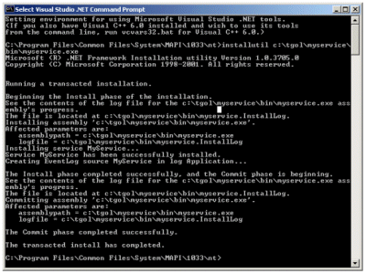
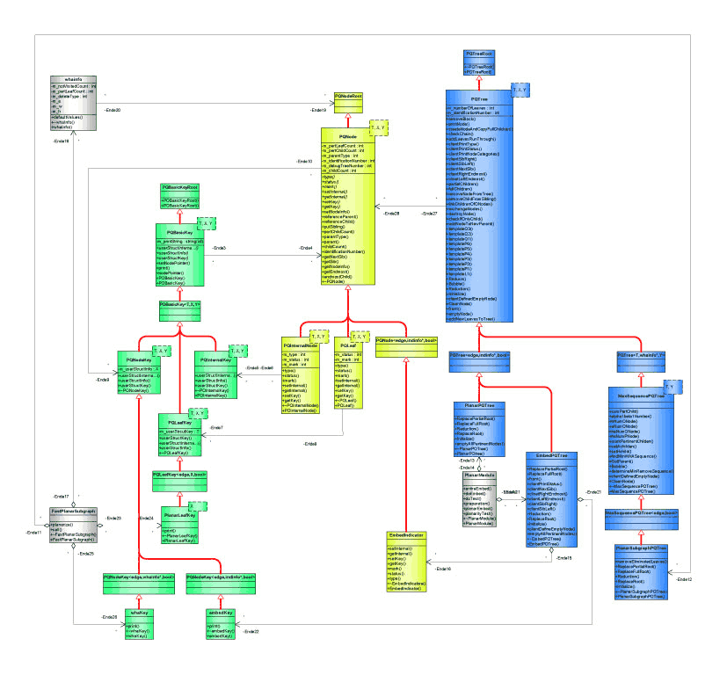
C3. Language Executability
Executable
With a model interpreter or model compiler, a modeling language can be executed as well.
A frequent goal of MDE is to enable code generation from models, and execute models directly.
Defining executability is not easy. For instance, some may consider EBNF as executable when applied in a parser generator.
Programming
Language
NON-executable
Modeling
Language

Slide 11
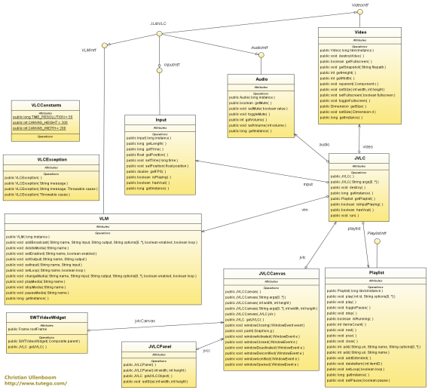
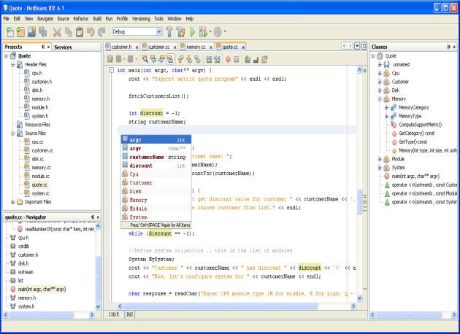
C4. Level of Abstraction
High Level
Many domain-specific languages raise the abstraction level, but may be a programming language.
Sometimes, abstraction level is difficult to measure.
Modeling
Language
Conform To
Programming
Language
Low Level

Slide 12
C5. Fundamental Concepts
Values, Storage, Bindings …
Programming
Language
Bindings can also be used in modeling languages.
Visual programming languages can also apply entities, connections.
Entities, connections …
Modeling
Language

Slide 13

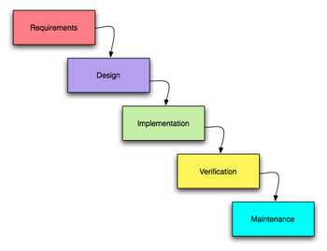

C6. Development Phase
Modeling
Language
Analysis & design
By raising the level of abstraction, domain-specific languages tend to be closer to design.
With executable models, a modeling language can play the role of implementation as well.
In some cases, languages can be used for diverse purposes. For example, a programming language can be used for modeling purposes.
implementation
Programming
Language

Slide 14
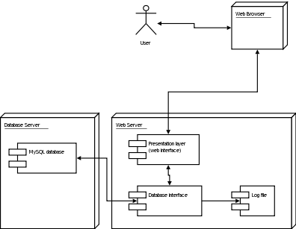
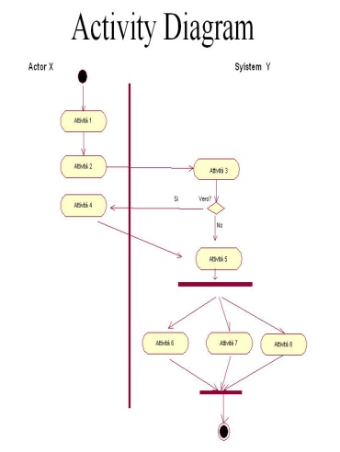
C7. Multiple Views
Multiple views
Modeling
Language
Some domains may be narrow enough that just one view is sufficient.
Single view
Programming
Language

Slide 15
How to use these criteria?
No single criterion can be used to make the decision.
Applying them together to make a comprehensive analysis is a better way.
We have selected a few DSLs and applied these criteria to determine if a language is a programming language or modeling language.

Slide 16
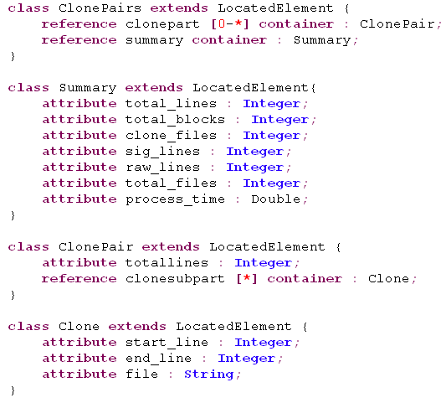
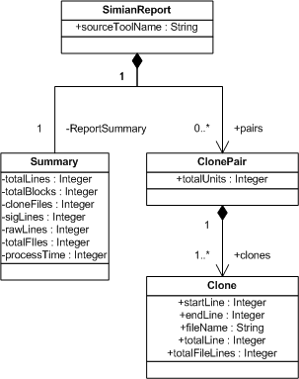
KM3 – Kernel Meta Meta Model
A DSL to define metamodels
Define

Slide 17
Criterion | KM3
Concrete Notation
Language Definition
Language Executability
Level of Abstraction
Fundamental Concepts
Development Phase
Multiple Views
Conclusion
Textual => P
EBNF, operational semantics => P
Not executable => M
High => M
Entities, connection => M
Requirement / design => M
No => P
Modeling

Slide 18
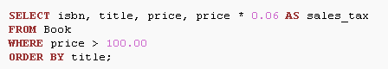
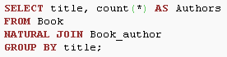
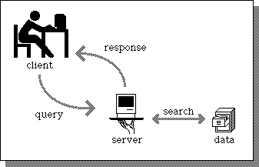
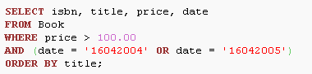
SQL – Structured Query Language
Provides retrieval and management of data facilities in relational database management systems

Slide 19
Criterion | KM3 | SQL
Concrete Notation | Textual => P | Textual => P
Language Definition | BNF, operational semantics => P | BNF, formal semantics => P
Language Executability | Not executable => M | Executable => P
Level of Abstraction | High => M | High / medium => M
Fundamental Concepts | Entities, connection => M | Values, storage, bindings => P
Development Phase | Requirement / design => M | Implementation => P
Multiple Views | No => P | No => P
Conclusion | Modeling | Programming

Slide 20
GReAT - Graph Rewriting and Transformation
A metamodel based model transformation language

Slide 21
Criterion | KM3 | SQL | GReAT
Concrete Notation | Textual => P | Textual => P | Graphical => M
Language Definition | BNF, operational semantics => P | BNF, formal semantics => P | Metamodel => M
Language Executability | Not executable => M | Executable => P | Executable => P
Level of Abstraction | High => M | High / medium => M | High => M
Fundamental Concepts | Entities, connection => M | Values, storage, bindings => P | Entities, connection => M
Development Phase | Requirement / design => M | Implementation => P | Implementation => P / M
Multiple Views | No => P | No => P | No => P
Conclusion | Modeling | Programming | Modeling

Slide 22
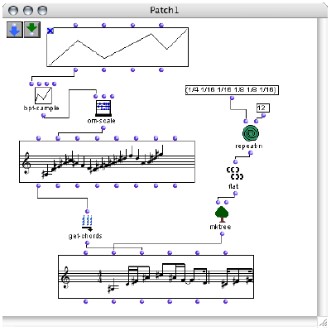
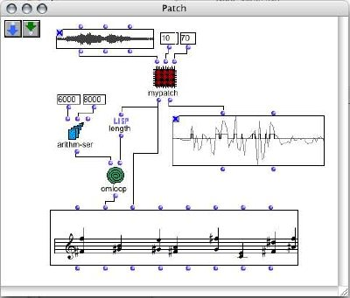
OpenMusic
An object-oriented visual programming language for musical composition

Slide 23
Criterion | KM3 | SQL | GReAT | OpenMusic
Concrete Notation | Textual => P | Textual => P | Graphical => M | Graphical => M
Language Definition | BNF, operational semantics => P | BNF, formal semantics => P | Metamodel , informal semantics=> M | Metamodel, informal semantics=> M
Language Executability | Not executable => M | Executable => P | Executable => P | Executable => P
Level of Abstraction | High => M | High / medium => M | High => M | Low => P
Fundamental Concepts | Entities, connection => M | Values, storage, bindings => P | Entities, connection => M | Entities, connection => M
Development Phase | Requirement / design => M | Implementation => P | Implementation => P | Implementation => P
Multiple Views | No => P | No => P | No => P | No => P
Conclusion | Modeling | Programming | Modeling | Programming

Slide 24
Conclusion
Observations
No single criterion can precisely determine the type of the language
Using multiple criteria to make classification is more effective and accurate
High level of abstraction, design phase, non-executable => Modeling language
Implementation phase, executable, the related fundamental concepts => Programming language

Slide 25
Conclusion
Benefits
If the group to which a particular language belongs is known, some general knowledge about that particular language is immediately available.
Help to organize existing knowledge about computer languages into hierarchical rankings and improve understanding and communication among researchers.
Knowing the type and characteristics is important when building a software engineering tool.

Slide 26
Questions?
Comments?
Yu Sun
yusun@cis.uab.edu
www.cis.uab.edu/yusun
This work funded in part by NSF CAREER award CCF-0643725

Slide 27
Criterion
Concrete Notation | Textual ML KM3 | Graphical PL Prograph
Language Definition | BNF ML KM3 | Metamodel PL Prograph
Language Executability | Executable ML GReAT | Unexecutable PL
Level of Abstraction | Low level ML GReAT | High level PL SQL
Fundamental Concepts | ML with PL concepts | PL with ML concepts Prograph
Development Phase | Implementation ML GReAT | Early PL
Multiple Views | Single ML KM3 | Multiple PL

